Slide 1
Data Warehousing and Knowledge Discovery
Instructor: Professor Cheng-Fa Tsai
Dept. of Management Information Systems
National Pingtung University of Science and Technology

Slide 2

文章題目：六大科技業 需才11萬 文章菁華：亞洲最大的台北國際電腦展（Computex）今日登場，根據104資訊科技最新統計，六大科技業工作機會將近11萬個，比去年同期增加6.1％，顯示雲端智慧、行動通訊和面板觸控的趨勢當道，其中，人才需求最多的是電腦及消費性電子，和軟體開發工程師等，共需近5萬。104資訊科技集團行銷處協理陳力孑表示，除了上述人才需求最多的兩項科技業職缺外，六大科技業中，人才需求成長最強的是電信通訊、年增18.1％，電子零組件，年增15.6％，再來是光電及光學，年增7.9％；半導體業徵才則年增4.1％，趨於平緩。值得注意的是，隨著民生消費的商業運作產生大量數據（big data），企業需要程式語言的數據分析（data mining），使得「演算法開發工程師」年資不到1年，平均年薪總額即逼近80萬元，高於其他種類的工程師。由於從Computex也可以觀察出，雲端、魔敗（mobile）、以及大數據的3大概念趨勢，產出5大相關工程師。包括演算法開發工程師、軟體設計工程師、Internet程式設計師、通訊軟體工程師、以及電腦系統分析師。 其中，演算法工程師最近5年的工作機會成長2.8倍、成長最強，其次為Internet程式設計師成長2.2倍，其他3項成長倍數介於1.1~1.5倍之間，對照「重軟不重硬」的產業人才趨勢，同一期間電腦硬體研發工程師工作機會成長0.9倍。演算法開發工程師年資不到1年的平均年薪總額即逼近80萬元，年資1~3年可達89萬元，年資3~5年可達94萬元，年資5~10年可達116萬元，年薪位居5大相關工程師之冠，也勝過薪資行情位居前段班的半導體工程師。另一方面，根據1111人力銀行資料庫中的5月最新資料顯示，資訊科技業相關職務即有近4.4萬個工作機會，4年來職缺成長了1.13倍。

Slide 3
Outline
DW, OLAP, DM
Definition
Techniques
Hypothesis Verification
Knowledge Discovery
Online Analytical Processing
Location Considerations
Benefits and Challenges

Slide 4
Data Mining
Analyzing the data in a data warehouse to reveal hidden patterns, relationship, and trends in historical business activity

Slide 5
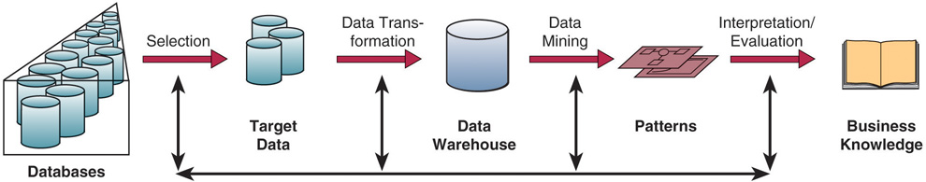
Data Mining
選取 轉換 探勘（型態） 解釋評估

Slide 6
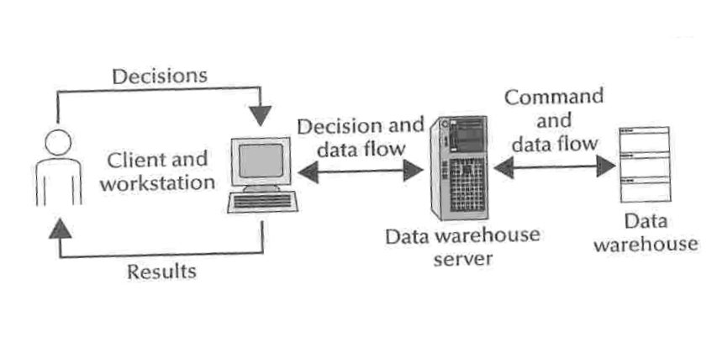
Mining for Decision Support

Slide 7
Data Mining Functions
Determining classifications for the data
Forming clusters from the data
Determining whether certain associations exist in the data
Determining whether any pattern or sequence exists in the data.

Slide 8
Data Mining Tapes
Hypothesis Verification
Querying
Modeling
User-driven
Knowledge Discovery
Patterns
System-driven

Slide 9
One example-Harrah’s gambling casino
Using stripe card called “Total Reward”
30% of customers spent $100 to $300, account for 80% of revenue and 100% of profit.
90 demographic segments
Age and distance are two factors of being a repeat customer

Slide 10
Data Mining Techniques
Recency, frequency, monetary (RFM)
Thirty-one permutations of sorting four variables (customer number, recency, frequency, monetary)
Inexpensive; easy to perform
Decision trees
More complex than RFM
Helps turn complex data representation into a much easier structure
Cluster analysis
Place customers/prospects into groups such that everyone in the group has similar traits
Categories include demographics, psychographics, behavioral, geographic

Slide 11
Other Data Mining techniques
Artificial neural network,
business intelligence (BI),
data stream mining,
fuzzy logic,
nearest neighbor algorithm,
pattern recognition,
relational data mining,
text mining,
chi-Square, t-test, regression, correlation

Slide 12
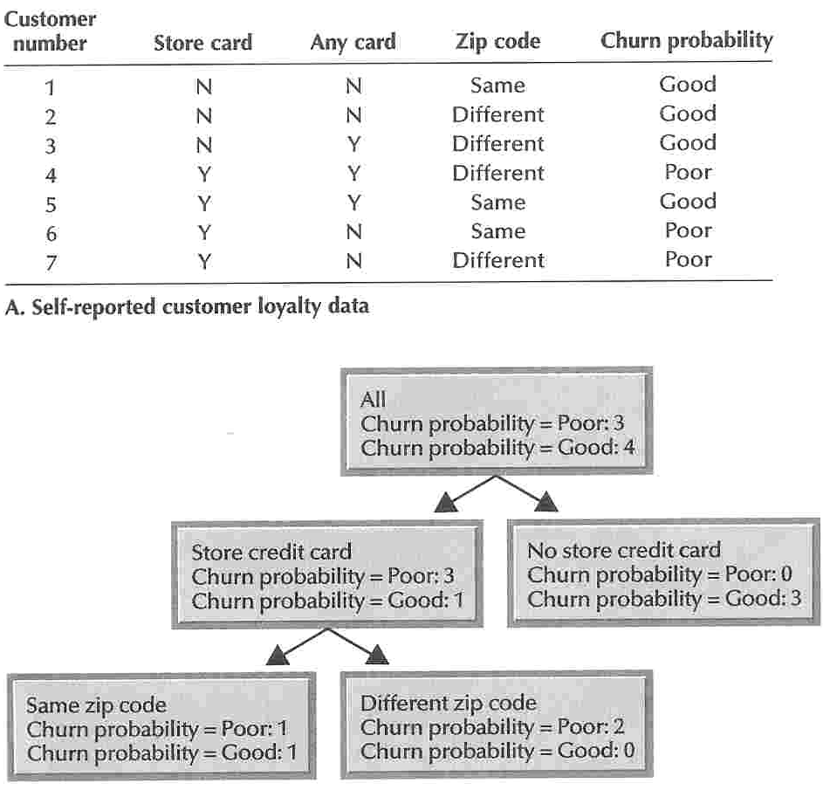
A Decision Tree

Slide 13
Genetic Algorithms
Software that uses Darwinian, randomizing, and other mathematical functions to simulate an evolutionary process that can yield increasingly better solutions to a problem

Slide 14
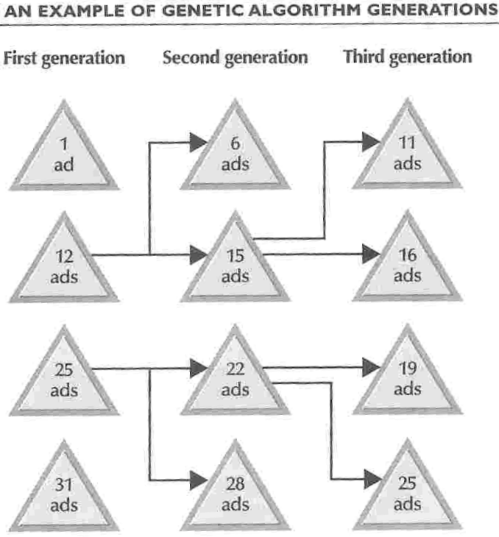

Slide 15
Memory Based Reasoning
Data records for entities that have a known behavior pattern are grouped to form a test case.
Records for customers with unknown purchase habits can be matched to the profile.
RFM (Recency, Frequency, Monetary level) is an example used as a predictor of future behavior.

Slide 16
Neural Networks
Definition:
Computing systems modeled after the brain’s mesh-like network of interconnected processing elements, called neurons
模擬人類的大腦架構，根據大腦的神經元(neurons)的處理元件(PE)所組成網路系統
能辨識出處理資料的模式與關係，所接受的資料範例愈多，學習效果也就越好
有一個輸入層、一個輸出層，以及數個隱藏的處理層。
每個PE節點對另一節點的影響力，視其不同權重而定。
Input代表問題的屬性，必須乘以「權重」，顯示其對下一個PE影響力的強弱，亦即權重不同，Output的結果就不同。
由輸入的過去案例，可依據Output與Input特性的關係，決定最好的結構與各路徑的權重，亦即所謂的機器學習。
要判斷的新案例輸入後，會自動預測出可能結果。

Slide 17
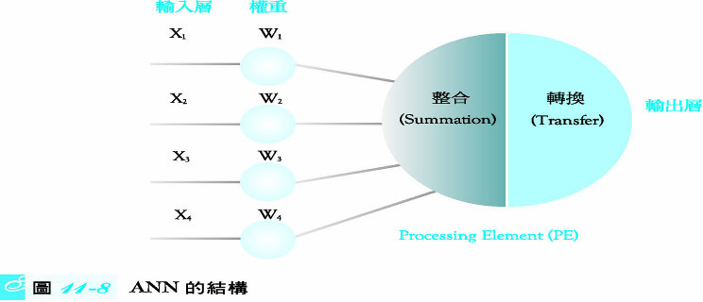
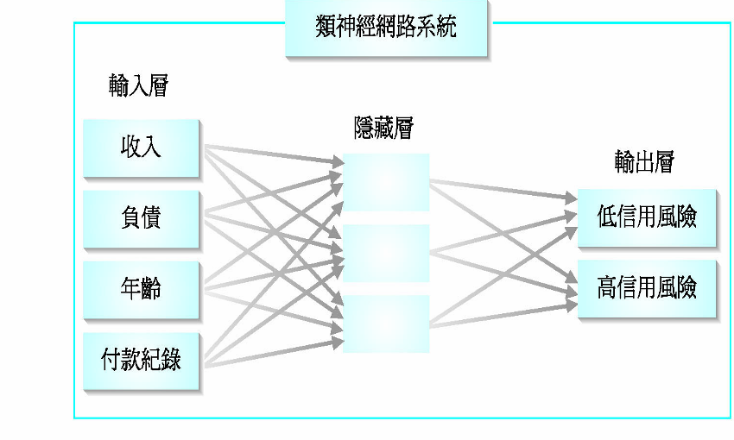
類神經網路基本概念與架構

Slide 18
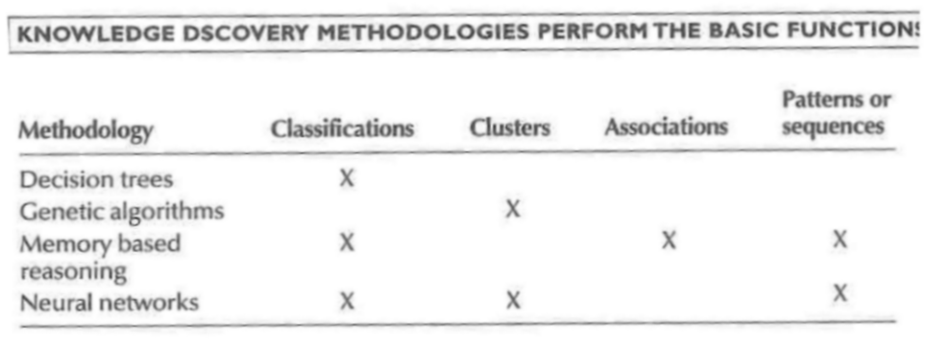

Slide 19
Online Analytical Processing
Enables mangers and analysts to interactively examine and manipulate large amounts of detailed and consolidated data from many perspectives

Slide 20
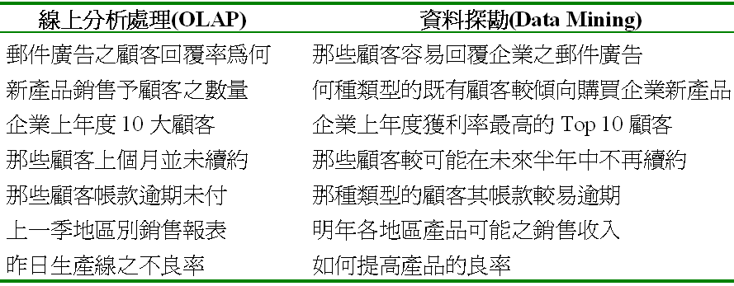

Slide 21
Analytical Operations
Consolidation – aggregation of data。
Drill-down – detail data that comprise consolidated data
Slice and Dice – ability to look at the database from different viewpoints

Slide 22
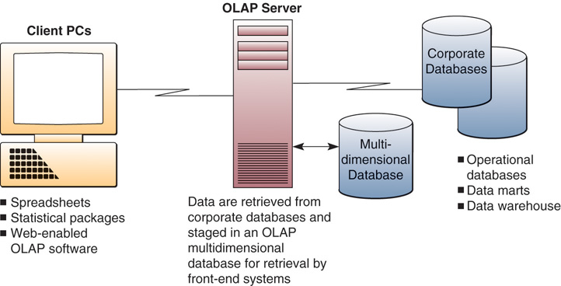
OLAP Technology

Slide 23
Types of data mining system environments
Decision Support Systems (DSS)
“List current inventory, predict sales of products to be promoted, and list inventory requirements by store”
“Determine who are responders and nonresponders for the last promotion”
“Identify nonresponders from the last promotion and send them a second promotional offer using a different advertising copy”

Slide 24
Types of data mining system environments
Executive Information Systems (EIS) – Dashboards
“Provide ROI results for all sales promotions for the last sixty days”
“Populate a spreadsheet with sales by product category from the Web, catalogue, and retail. Allow for simple data manipulation for the purpose of creating trend reports”

Slide 25
Types of data mining system environments
Enterprise Resource Planning (ERP)
“Process all online orders within twelve hours and send alert to quality and control when time limit is exceeded”
“Automatically notify supplier to restock when inventory depletes to certain level”
“Update customer service ODS with current customer order status information”

Slide 26
Types of data mining system environments
CRM
“Identify the most profitable customers by household level for the last twenty-four months and create a recognition strategy at different incremental levels based on profitability level”
“Determine which customers have purchased for their own consumer needs versus on behalf of the company they work for and create a profitability index for each”
“Examine customer purchase history and build a channel preference profile for each customer including time variations such as ‘snowbirds’”

Slide 27
Data Mining Location and access considerations
Operational Data Store (ODS)
Dynamic data repository
Tactical and decision report applications
Data limited to current operational needs
Data warehouse (DW)
More static than ODS
Large depth and breadth of information
Data transformed into knowledge
Analysis strategy and planning applications
Data marts (DM)
Receives data from DW or ODS, but usually the former
Limited but concentrated information
Data transformed into knowledge
Analysis, strategy and planning applications
Usually designed for use as a narrow application
Data mining and statistics

Slide 28
Data Mining Benefits
Better understanding of customers and prospects supports relationship building efforts
Measurable
Precipitate new opportunities
Fraud detection and identification of nonfavorable behavior

Slide 29
Data Mining Challenges
Organizational obstacles to attaining data
Cost versus benefit
Ability to capture data
Giving customer/prospect perception of invasiveness
Privacy issues
Ability to perform data and information transformation
Technology and analytical expertise
“Analysis Paralysis”

Slide 30

Introduction
1.(Devlin,1997)
Information is pivotal in today’s business environment.
Success is dependent on its early and decisive use. A lack of of information is a sure sign for failure.
The rapidly changing environment in which business operates demands ever more immediate access to data.
2.(Poe,1996)
Many corporations are actively looking for new technologies that will assist them in becoming more profitable competitive.
Gaining competitive advantage requires that companies accelerate their decision making process so that they can respond quickly to change.
One key to this accelerated decision making is having the right information, at the right time, easily accessible.

Slide 31
What is Data Warehouse?
􀂄Defined in many different ways, but not rigorously.
􀂄A decision support database that is maintained separately from the organization’s operational database.
􀂄Support information processing by providing a solid platform of consolidated, historical data for analysis.
􀂄“A data warehouse is asubject-oriented,integrated, time-variant, and nonvolatilecollection of data in support of management’s decision-making process.”—W. H. Inmon
􀂄Data warehousing:The process of constructing and using data warehouses

Slide 32
Conceptual Modeling of Data Warehouses
•
Modeling data warehouses: dimensions & measures
•
Star schema: A fact table in the middle connected to a set of dimension tables
Snowflake schema: A refinement of star schema
where some dimensional hierarchy is normalized into a set of smaller dimension tables, forming a shape similar to snowflake
Fact constellations: Multiple fact tables share
dimension tables, viewed as a collection of stars,
therefore called galaxy schema or fact constellation

Slide 33
背景
資訊科技改變了商業的經營方式
如何有效的運用資訊科技來累積、創造與分享知識？

Slide 34
什麼是知識？
資訊的「內部化」
思考、內化
感覺
說
看
寫
聽
分享

Slide 35
知識相關活動
需要獲取、累積、擴散、產生、應用、修正
知識取得
彙整、搜尋
知識累積
知識產生
推理
比對、類比
知識分享
知識擴散應用
解決知識性問題

Slide 36
資料、資訊、知識、智慧
透過應用
創造價值
智慧
開創價值
知識
資訊
整理以傳達意念
資料
顯示事實

Slide 37
個人知識與組織知識
知識
種類
個人知識
(Individual Knowledge)
組織知識
(Organizational Knowledge)
定
義
＊歸屬於個人的知識與 智慧
＊個人可再利用、活用
＊難以共享
＊有助於組織創新
＊易於與他人共享
＊組織資產、穩定
實
例
◎感覺、嗜好
◎經驗、體驗
◎人脈
◎創意.靈感
◎研討資料
◎技術與專業知識
◎顧客資料、人物簡介
◎帳簿類.提案書.
業務手冊
◎方法論與工具
◎設計圖、設計
圖、手冊集
◎智慧財產權

Slide 38
個人知識＋組織知識
將知識具體化呈現、促成分享
即藉用一些方法將隱藏於個人內在的知識具體展現出來
社群的營造

Slide 39
文明發展的衝擊
資料和資訊氾濫
知識成指數累積、成長
過去的工作方法，受決定該方法時的環境和科技條件所影響
環境改變了
科技條件改變了
資產變負債的可能

Slide 40
資訊超載(Information overload)
人的資訊通道的過濾功能在壓力下增加
如何利用IT解決超載？
反
應
刺激

Slide 41
知識管理
在知識型企業中，建構有效的系統整理大量知識
促使個人知識和組織知識結合產生綜效
使知識能夠有效的累積、搜尋、創造、流通與加值
創新的作法，創新的產品和服務

Slide 42
個人與組織知識的結合
資訊科技促成新的處理方式
做到過去不可能的事
將個人知識累積，和組織知識彙整
建立累積、分享的管理機制

Slide 43
知識管理重要元素架構圖
Technology(+):資訊科技
資訊科技協助知識管理
的建構
Share=分享
知識管理架構
KM=( P + K )^{S}
Knowledge:知識
資料.資訊.知識.智慧
People:人
知識運載者

Slide 44
一些相關的名詞
BI: Business Intelligence 商業智慧
商業化工具
從企業內部系統，擷取資料加以分析
Data Warehousing 資料倉儲
將企業大量的營運資料加以綜合儲存
Data Mining 資料探勘
將資料倉儲中的大量資料加以分析，挖掘出有用的知識
Work Flow
將工作流程自動化，並藉以保存文件

Slide 45
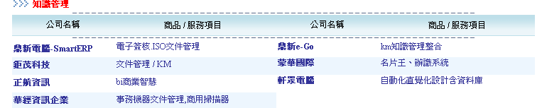
知識管理系統軟體

Slide 46
支援不同知識格式型態的IT工具
支援數字導向 | 支援文件導向 | 支援溝通討論 導向 | 支援智慧型知識 儲存導向 | 支援多媒體導向
資料倉儲 資料探勘 模式模擬 | 文件管理系統 工作流程系統 智慧代理人 搜尋引擎 網際網路 電腦輔助設計 文件探勘 | 電子布告欄 電子郵件 群組軟體 聊天室 電子視訊會議 網際網路 企業內部網路 企業外部網路 電子論壇 | 專家系統 案例推理系統 常見問題解答集(FAQ) 智慧代理人 人工智慧 劇本模擬 | 虛擬實境 多媒體管理系統 網際網路 電子視訊會議 線上學習

Slide 47
支援不同知識管理步驟的主要IT工具
支援知識的定義 | 支援知識的獲取 | 支援知識的創造 | 支援知識的儲存 | 支援知識的擷取與利用 | 支援知識的分享傳遞 | 支援多種流程的整合型IT
搜尋引擎 智慧代理人 知識地圖 專家黃頁 | 企業內部網路 企業外部網路 網際網路 群組軟體 搜尋引擎 協同商務 | 繪圖輔助的設計 案例推理系統 資料探勘 模式模擬 協同過濾系統 腦力激盪支援軟體 | 全球資訊網 資料庫 資料倉儲 文件管理系統 知識庫 工作流程系統 | 全球資訊網 搜尋引擎 文件探勘 線上即時分析 介面設計軟體 企業入口網站 | 網際網路 全球資訊網 企業內部網路 企業外部網路 群組軟體 工作流程系統 | 企業入口網站 知識管理系統

Slide 48
支援不同知識管理步驟的主要IT工具（續）
支援知識的定義 | 支援知識的獲取 | 支援知識的創造 | 支援知識的儲存 | 支援知識的擷取與利用 | 支援知識的分享傳遞 | 支援多種流程的整合型IT
 |  | 群組群體 BBS 聊天室 虛擬實境軟體 | 常見問題集解答(FAQ) 專家系統 案例推理系統 | 智慧代理人 | 電子視訊會議 e化企業社群 BBS 聊天室 群組決策支援系統

Slide 49
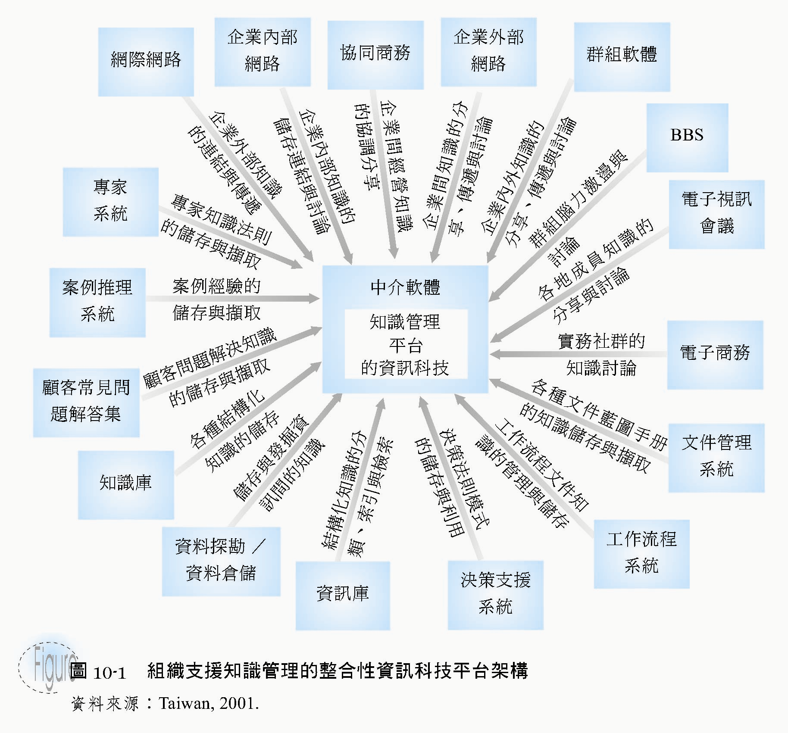
組織支援知識管理的整合性資訊科技平台架構
知識管理的資訊
科技平台

Slide 50
Introduction (information gap)
1.The fragmented way in which organizations have developed information systems—and their supporting databases—for many years. In reality constraints on time and resources cause most organizations resort to a “one-thing-at-a-time” approach to developing systems.
2.Most systems are developed to support operational processing, with little or no thought given to the information or analytical tools needed for decision making.
Operational processing, also called transaction processing, captures, stores, and manipulates data to support daily operations of the organization.
Information processing is the analysis of summarized data or other formed of information to support decision making.

Slide 51
Introduction—data warehouse
1.Bridging the information gap are data warehouses.
2.Definition—(Martin,1997)
Data warehouses consolidate and integrate information from many different sources and arrange it in a meaningful format for making accurate business decision.
They support executives, managers, and business analysts in making complex business decisions through applications such as the analysis of trends, target marketing, competitive analysis, and so on.
Data warehousing has evolved to meet these needs without disturbing existing operational processing.

Slide 52
Basic concepts of data warehousing
A data warehouse is a subject-oriented, integrated, time-variant, nonvolatile collection of data used in support of management decision making processes (Inmon,1994)
1.Subject-oriented—major subjects may include customers, patients, students, and products.
2.Integrated—using consistent naming conventions, formats, encoding structures, and related characteristics.

Slide 53
Basic concepts of data warehousing
3.Time-variant—data in the data warehouse contain a time dimension so that they may be used as a historical record of the business.
4.Nonvolatile—data in the data warehouse are loaded and refreshed from operational systems, but cannot be updated by end users.

Slide 54
Data warehouse
1.Data warehousing is the process whereby organizations extract meaning from their information assets through the use of data warehouses
2.Data warehousing is a recent initiative in information technology.
3.Since it began about 10 years ago, it has evolved so rapidly that data warehousing is now one of the hottest topics in information systems.

Slide 55
Data warehouse
4.Studies repeatedly show that over 90 percent of larger companies either have a data warehouse or starting one.
5.A 1996 study of 62 data warehousing projects showed an average return on investment of 321 percent, with an average payback period of 2.73 years.
6.Users are expected spend nearly $200 billion on data warehouse technology over the next 5 years.

Slide 56
Data warehouse—rules define a data warehouse
1.The data warehouse and operational environments are separated.
2.The data warehouse data are integrated.
3.The data warehouse contains historical data over a long time horizon.
4.The data warehouse data are snapshot data captured at a given point in time.

Slide 57
Data warehouse—rules define a data warehouse
5.The data warehouse data are subject-oriented.
6.The data warehouse data are mainly read-only with periodic batch updated from operational data. No online updates are allowed.
7.The data warehouse data development life cycle differs from classical systems development. The data warehouse development is data driven; the classical approach is process driven.

Slide 58
8.The data warehouse contains data with several levels of detailed:current detail data, old detail data, lightly summarized, and highly summarized data.
9.The data warehouse environment is characterized by read-only transactions to very large data sets. The operational environment is characterized by numerous update transactions to a few data entities at the time.
Data warehouse—rules define a data warehouse

Slide 59
Data warehouse—rules define a data warehouse
10.The data warehouse environment has a system that traces data sources, transformations, and storage.
11.The data warehouse’s metadata are a critical component of this environment. It provides the source, transformation, integration, storage, usage, relationships, and history of each data element.

Slide 60
The need for data warehousing
1.Business need for a company-wide view ~ Examples of heterogeneous data.
Some of the issues that you must resolve as follows:
A.Inconsistent key
B.Synonyms
C.Free-form fields versus structure fields
D.Inconsistent data values
E.Missing data
2.Need to separate operational and informational systems

Slide 61
Comparison of operational and information systems
characteristic | operational sys. | Informational sys.
Primary purpose | Run the business on a current basis | Support managerial decision making
Type of data | Current representation of state of the business | Historical or point-in-time (snapshots)
Primary users | Clerks,salespersons, administrators | Managers,business analysts,customers
Scope of usage | Narrow vs. simple updates and queries | Broad vs. complex queries and analysis
Design goal | Performance | Ease of access and use

Slide 62
Data Warehouse Principle 1
For most organizations today, it is
essential to separate informational
processing from operational processing
by creating a data warehouse.

Slide 63
Generic Two-Level Architecture
Building this architecture requires four basic steps:
1.Data are extracted from the various source system files and databases. In a large organization there may be dozens or even hundreds of such files and databases.
2.The data from the various source systems are transformed and integrated before being loaded into the data warehouse.

Slide 64
Generic Two-Level Architecture
3.The data warehouse is a read-only database organized for decision support. It contains both detailed and summary data.
4.Users access the data warehouse by means of a variety of query languages and analytical tools.

Slide 65
Three-layer architecture
1.Operational systems and data
2.Enterprise data warehouse ~ A centralized, integrated data warehouse that is the control point and single source of all data made available to end users for decision-support applications.
3.Data marts ~ A data warehouse that is limited in scope, whose data are obtained by selecting and (where appropriate) summarizing data from the enterprise data warehouse.

Slide 66
Three-layer data architecture
Derived data
Data mart
metadata
Data mart
EDW
metadata
Reconciled data
Enterprise data warehouse
Enterprise
Data model
Operational
metadata
Operational data
Operational systems

Slide 67
Data Warehouse Principle 2 ~ Large organizations with many heterogeneous data sources should adopt a three-level data warehouse architecture.
Three-layer data architecture
1.Operational data are stored in the various operational systems throughout the organization.

Slide 68
Three-layer data architecture
2.Reconciled data are the type of data stored in the enterprise data warehouse. Reconciled data are detailed, historical data intended to be the single, authoritative source for all decision-support applications. Reconciled data are generally not intended to be accessed directly by end users.
3.Derived data are the type of data stored in each of the data marts. They are data that have been selected, formatted, and aggregated for end-user decision-support applications.

Slide 69
Role of metadata
1.Operational metadata describe the data in the various operational systems that feed the enterprise data warehouse. Operational metadata typically exist in a number of different formats and unfortunately are often of poor quality.
2.Enterprise data warehouse (EDW) metadata are derived from (or at least consistent with) the enterprise data model. EDW metadata describe the reconciled data layer as well as the rules for transforming operational data to reconciled data.
3.Data mart metadata describe the derived data layer and the rules for transforming reconciled data to derived data.

Slide 70
Some data characteristics
Transient data: Data in which changes to existing records are written over previous records, thus destroying the previous data content.
Periodic data: Data that are never physically altered or deleted, once they have been added to the store.

Slide 71
Characteristics of Reconciled data
1.Detailed ~ The data are detailed (rather than summarized), providing maximum flexibility for various user communities to structure the data to best suit their needs.
2.Historical ~ The data are periodic to provide a historical perspective.
3.Normalized ~ Provide great integrity and flexibility of use.
4.Comprehensive ~ Reflect an enterprise-wide perspective.
5.Quality Controlled ~ Provide quality and integrity, since they are summarized into the data marts and used for decision making.

Slide 72

Steps in data reconciliation
Scrub
Transform
Capture
Load and Index
Data reconciliation
Operational
systems
Enterprise data warehouse

Slide 73

Capture
1.Extracting the relevant data from the source files and databases used to fill the EDW is called capture.
2.Not all of the data contained in the various operational systems are required, but just a subset.
3.Capturing the subset of data is based on an extensive analysis of both the source and target systems, which is best performed by a team directed by data administration and composed of both end users and data warehouse professionals.

Slide 74
Capture
4.Static capture ~ Capture a snapshot of the required source data at a point in time.
5.Incremental capture ~ Captures only the changes that have occurred in the source data since the last capture.

Slide 75

Scrub
Data in operational systems are often of poor quality. Some of errors and inconsistencies typical of these data are as follows:
1.Misspelled names and addresses
2.Impossible or erroneous dates of birth
3.Fields used for purposes for which they were never intended.
4.Mismatched addresses and area codes.
5.Missing data
Data scrubbing ~ A technique using pattern recognition and other artificial intelligence techniques to upgrade the quality of raw data before transforming and moving the data to the data warehouse. Also called data cleansing.

Slide 76
Data Transformation
Center of the data reconciliation process.
Convert data from the format of the source operational systems to the format of the enterprise data warehouse
The goal ~Data Scrubbing correct errors in data values
The goal ~ Data Transformation Correct errors in data format

Slide 77

Data Transformation
1.Record-level functions ~ Operating on a set of records, such as a file or table, are the record-level functions most important: selection, joining, normalization, and aggregation
2.Field-level functions ~ Convert data from a given format in a source record to a different format in a target record
Single-field transformation (2) Multifield transformation

Slide 78

Load and Index
The last step in filling the enterprise data warehouse is to load the selected data into the target data warehouse and to create the necessary indexes.
1.Refresh mode ~ an approach to filling the enterprise data warehouse that employs bulk rewriting of the target data at periodic intervals.
2.Update mode ~ an approach in which only changes in the source data are written to the data warehouse.

Slide 79

Tool to Support Data Reconciliation
Data Conversion Tools
Data-Cleansing Tools
Data Quality Tools

Slide 80
Characteristics of Derived Data
Objectives:
1.Provide ease of use for decision-support applications
2.Provide fast response for user queries or requests for information
3.Customize data for particular target user groups
4.Support ad-hoc queries and data-mining applications

Slide 81
Characteristics of Derived Data
Characteristics:
1.Both detailed and aggregate data are present
A.Detailed data are often (but not always) periodic—Provide a historical record
B.Aggregate data are formatted to respond quickly to predetermined (or common) queries.
2.Data are distributed to departmental servers.
3.The data model that is most commonly used is the star schema.

Slide 82
The Star Schema
Def: A simple database design in which dimensional data are separated from fact or event data. A dimensional model is another name for star schema.
Purpose: It ‘s suited to ad-hoc queries, but not suited to OLTP.
Structure: Consist of fact tables and dimension tables.
Fact tables: Factual or quantitative data about a business such as units sold, orders booked

Slide 83
The Star Schema
Dimension tables: Hold descriptive data about the business.
The simplest star schema consists of one fact table, surrounded by several dimension tables.
Typical business dimensions are Product, Customer, and Period.
Each dimension table has one-to-many relationship to the central fact table.
Each dimension table generally has a simple primary key, as well as several nonkey attributes.
The primary key in turn is a foreign key in the fact table

Slide 84
The Star Schema
The primary key of the fact table is a composite key that consists of the concatenation of all of the foreign keys
The relationship between each dimension table and fact table provides a join path that allows users to query the database easily, using SQL statements for either predefined or ad-hoc queries
Nonkey attributes are generally called data columns.
The fact table plays the role of an associative entity that links the instances of various dimensions.

Slide 85
Example of Star Schema
Refer to Fig. 14-11, 14-12, and 14-13
Grain of a fact table ~ The length of time (or other meaning) associated with each record in the table. E.g. Monthly item totals, finer grain would be weekly item totals or daily totals
The choice of the grain of the fact table depends on the amount of detail users require when querying the table.

Slide 86
Example of Star Schema
This would allow users to perform market basket analysis, which is the study of buying behavior of individual customers.
Size of the fact table:
E.g.~ total rows = 1000 stores*5000 active products*24 months
= 120,000,000 row
Total size = 120,000,000 rows*6 fields*4 bytes/field
= 2,880,000,000 bytes or 2.88 gigabytes

Slide 87
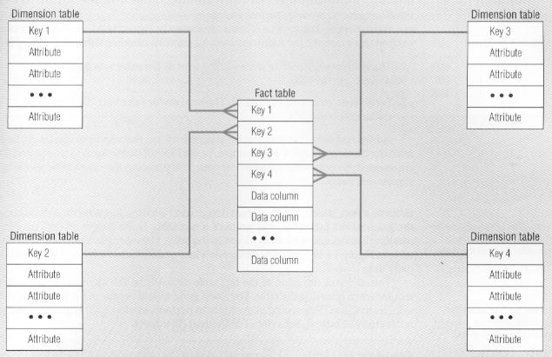
Fig 14-11.

Slide 88
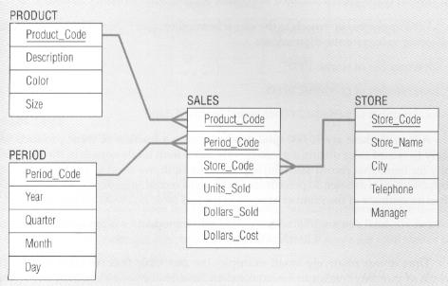
Fig 14-12.

Slide 89
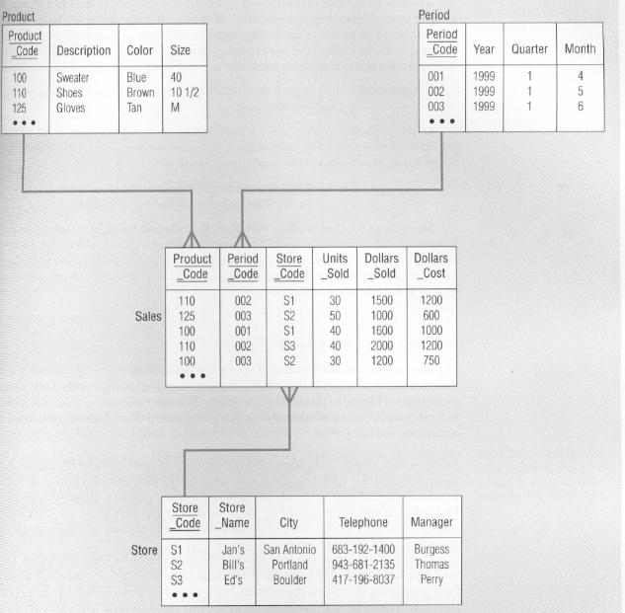
Fig 14-13.

Slide 90
Snowflake Schema
Def: An expanded version of a star schema in which all of the tables are fully normalized.
Sometimes a dimension in a star schema forms a natural hierarchy.
A geographic is a typical example of this situation .
E.g.~A dimension named Market. The following geographic hierarchy may exist:
1.There are several markets within a state.
2.There are several states within a region.
3.There are several regions within a country.
E.g.~ Refer to Fig 14-14, 14-15

Slide 91
On-Line Analytical Processing (OLAP)
Functionalities:
1.Slice and dice: Performing projection operations on the dimensions.
E.g.~Fig 14-16:Slicing the data cube to produce a simple two-dimensional table or view. This slice is for the product named “shoes.”
The resulting table shows the three measures (units, revenues, and cost) for this product by period (or month)
Other views can easily be developed by the user by means of simple “drag and drop” operations.

Slide 92
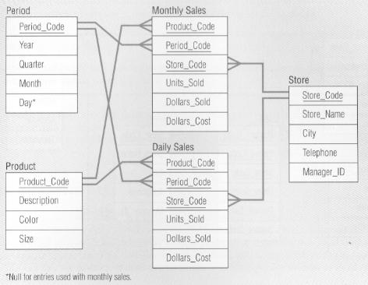
Fig 14-14.

Slide 93
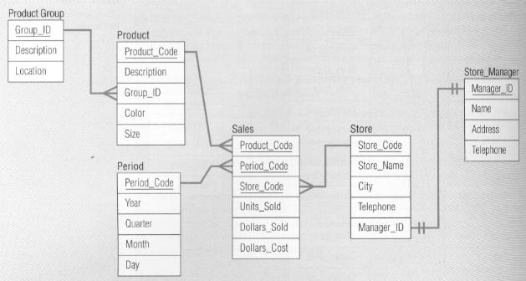
Fig 14-15.

Slide 94
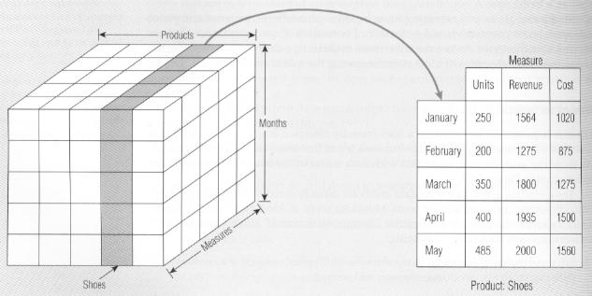
Fig 14-16.

Slide 95

On-Line Analytical Processing (OLAP)
Roll-up: Data is summarized with increasing generalization (e.g., weekly to quarterly, to annually).
Roll-up display moves up the hierarchy, grouping into larger units along a dimension. E.g., summing weekly data by quarter, or by year.
E.g., Fig. 26.5 shows a roll-up display that moves from individual products to a coarser grain of product categories.

Slide 96
On-Line Analytical Processing (OLAP)
Another type of operation often used in multidimensional analysis is drill-down.
Drill-down: Increasing levels of detail are revealed (the complement of roll-up).
Analyzing a given set of data at a finer level of detail.
E.g., Fig.26.6: Furnishing a finer-grained view, perhaps disaggregating country sales by region and then regional sales by subregion and also breaking up products by style.

Slide 97
On-Line Analytical Processing (OLAP)
E.g., Fig. 14-17:Fig. 14-17a shows a summary report for the total sales of three package sizes for a given brand of paper towels—2-pack, 3-pack, and 6-pack. The towels come in different colors, and the analyst wants a further breakdown can be easily obtained using a “point-and-click” approach with a mouse device.
A drill-down presentation (Fig. 14-17b) is equivalent to adding another column to the original report
(In this case color)

Slide 98

Fig 14-17(a).

Slide 99
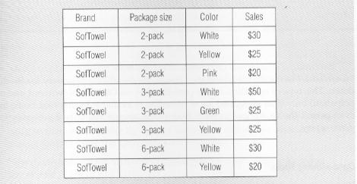
Fig 14-17(b).

Slide 100
On-Line Analytical Processing (OLAP)
Pivot: Cross tabulation ( rotation) is performed.
Refer to rotating the view for a particular data point, to obtain another perspective.
E.g., Fig. 14-16 shows sales of 400 units of shoes for April.
The analyst could pivot this view to obtain (for example) the sales of shoes by stores for the same month.
Sorting: Data is sorted by ordinal values.
Selection: Data is available by value or range.
Derived (computed) attributes: Attributes are computed by operations on stored and derived values.

Slide 101
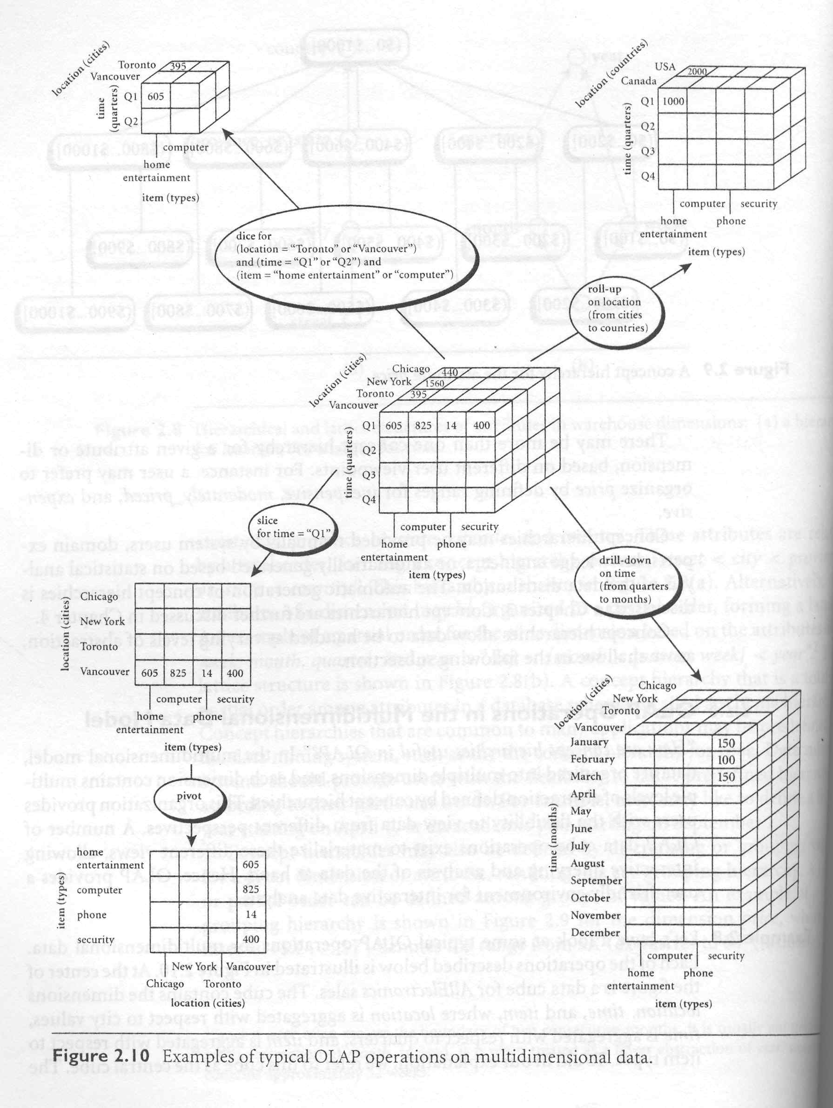

Slide 102
Data-Mining
The goal of a data warehouse is to support decision making with data. Data mining can be used in conjunction with a data warehouse to help with certain types of decisions.
To make data mining more efficient, the data warehouse should have an aggregated or summarized collection of data.
Data mining helps in extracting meaningful new patterns that cannot be found necessarily by merely querying or processing data or metadata in the data warehouse.

Slide 103
Data-Mining
Data mining applications should therefore be strongly considered early, during the design of a data warehouse.
Data mining tools should be designed to facilitate their use in conjunction with data warehouses.
Def. of Data Mining: Knowledge discovery using a sophisticated blend of techniques from traditional statistics, artificial intelligence, and computer graphics (Weldon, 1996).

Slide 104
KDD
Knowledge discovery in databases (KDD) six phases:
1. Data selection
2. Data cleansing
3. Enrichment
4. Data transformation or encoding
5. Data mining
6. The reporting and display of the discovered information
Data mining as a part of the knowledge discovery process

Slide 105

KDD
e.g., A database maintained by a specialty consumer goods retailer
Suppose the client data includes a customer name, zip code, phone number, date of purchase, item code, price, quantity, and total amount
1. Data selection~ data about specific items or categories of items, or from stores in a specific region or area of the country, may be selected.
2. Data cleaning~ may correct invalid zip codes or eliminate records with incorrect phone prefixes.

Slide 106

KDD
3. Enrichment~ enhances the data with additional sources of information. E.g., given the client names and phone numbers, the store may purchase other data about age, income, and credit rating and append them to each record.
4. Data transformation and encoding~ may be done to reduce the amount of data.
E.g., item codes may be grouped in terms of product categories into audio, video, supplies, electronic gadgets, camera, accessories, and so on.
Zip codes may be aggregated into geographic regions, incomes may be divided into ten ranges, and so on.

Slide 107

KDD
5. Data mining~ used to mine different rules and patterns. E.g.,
(1)Association rules~ e.g., whenever a customer buys video equipment, he or she also buys another electronic gadget.
(2)Sequential patterns~ e.g., suppose a customer buys a camera, and within three months he or she buys photographic supplies, and within six months an accessory item. A customer who buys more than twice in the lean periods may be likely to buy at least once during Christmas period.

Slide 108
KDD
(3)Classification trees~ e.g., customers may be classified by frequency of visits, by types of financing used, by amount of purchase, or by affinity for types of items, and some revealing statistics may be generated for such classes.
Many possibilities exist for discovering new knowledge about buying patterns, relating factors such as age, income-group, place of residence, to what and how much the customers purchase.

Slide 109

KDD
This information can then be utilized to plan additional store locations based on demographics, to run store promotions, to combine items in advertisements, or to plan seasonal marketing strategies.
As this retail-store example useful information that can directly influence business decisions.
6. The reporting and display of the discovered information~ the results of data mining may be reported in a variety of formats, such as listings, graphic outputs, summary tables, or visualizations.

Slide 110
Goals of Data Mining and KDD
Prediction~DM can show how certain attributes within the data will behave in the future.
Examples of predictive DM include
(1) the analysis of buying transactions or
(2) predict what consumers will buy under certain discounts,
(3) how much sales volume a store would generate in a given period, and
(4) whether deleting a product line would yield more profits.

Slide 111
Goals of Data Mining and KDD
In such applications, business logic is used coupled with DM.
In a scientific context, certain seismic wave patterns may predict an earthquake with high probability.
Identification~ Data patterns can be used to identify the existence of an item, an event, or an activity.
E.g., intruders trying to break a system may be identified by the programs executed, file accessed, and CPU time per session.

Slide 112

Goals of Data Mining and KDD
The area known as authentication is a form of identification.
It ascertains whether a user is indeed a specific user or one from an authorized class,
It involves a comparison of parameters or images or signals against a database.

Slide 113

Goals of Data Mining and KDD
Classification~ DM can partition the data so that different classes or categories can be identified based on combinations of parameters.
e.g., customers in a supermarket can be categorized into discount-seeking shoppers, shoppers in a rush, loyal regular shoppers, and infrequent shoppers.
This classification may be used in different analyses of customer buying transactions as a post-mining activity.

Slide 114

Goals of Data Mining and KDD
Sometimes classification based on common domain knowledge is used as an input to decompose the mining problem and make it simpler
Eg., health foods, party foods, or school lunch foods are distinct categories in the supermarket business..
It makes sense to analyze relationships within and cross categories as separate problems.

Slide 115
Goals of Data Mining and KDD
Such categorization may be used to encode the data appropriately before subjecting it to further data mining.
Optimization~One eventual goal of DM may be to optimize the use of limited resources such as time, space, money, or materials and to maximize output variables such as sales or profits under a given set of constraints.
As such, this goal of data mining resembles the objective function used in operations research problems that deals with optimization under constraints.

Slide 116
Data Mining Tools
With OLAP, users are searching for answers to questions they have raised—e.g., “Are health care costs greater for single or married persons?”
With DM, users are looking for patterns or trends in a collection of facts or observations.
DM~ Knowledge discovery using a sophisticated blend of techniques from traditional statistics, artificial intelligence, and computer graphics (Weldon, 1996).

Slide 117
The Goals of Data Mining
Explanatory~ To explain some observed event or condition, such as why sales of pickup trucks have increased in Colorado.
Confirmatory~ To confirm a hypothesis, such as whether two-income families are more likely to buy family medical coverage than single-income families.
Exploratory~ To analyze data for new or unexpected relationships, such as what spending patterns are likely to accompany credit card fraud.

Slide 118
Data-Mining Techniques
Case-based reasoning~ Derives rules from real-world case examples
Rule discovery~ Searches for patterns and correlations in large data sets
Signal processing~ Identifies clusters of observations with similar characteristics
Neural nets~ Develops predictive models based on principles modeled after the human brain

Slide 119
Typical DM Applications (Zaitz,1997)
Type of Application | Example
Analysis of business trends | Identifying markets with above average (or below average) growth.
Profiling populations | Developing profiles of high-value customers, credit risks, and credit-card fraud.
Target marketing | Identifying customers (or customer segments) for promotional activity.

Slide 120
Typical DM Applications (Zaitz,1997)
Type of Application | Example
Usage analysis | Identifying usage patterns for products and services
Campaign effectiveness | Comparing campaign strategies for effectiveness
Product affinity | Identifying products that are purchased concurrently, or the characteristics of shoppers for certain product groups

Slide 121
The reasons for DM applications are growing rapidly
The amount of data in data warehouses and data marts is growing exponentially, so that users require the type of automated techniques provided by DM tools to mine the knowledge in these data.
New DM tools with expanded capabilities are continually being introduced.
Increasing competitive pressures are forcing companies to make better use of the information and knowledge contained in their data.

Slide 122
Data Visualization
Often the human eye can best discern patterns when data are represented graphically.
Def.~ Data visualization is the representation of data in graphical and multimedia formats for human analysis.
Benefits~ (1) the ability to better observe trends and patterns (2) to identify correlations and clusters.
Data visualization is often used in conjunction with DM and other analytical techniques.

Slide 123
Homework-1:
Visit the following Internet Web sites. Browse these sites for additional information on data warehouse topics, including case examples of warehouse implementations,descriptions of the latest warehouse-related products, and announcements of conferences and other events.
A.Data-warehouse.com:http://www.data-warehouse.com
B.The Data Warehousing Institute:http://www.dw-institute.com
C.Knowledge Discovery Mine:http://www.kdnuggets.com
D.Data Ming Institute:http://www.datamining.org
E.Data Warehousing Information Center http://www.pwp.starnetinc.com/larryg/index.html
F.Data Mining and Knowledge Discovery Journal:http://www.research.microsoft.com/research/datamine

Slide 124
Visualization Technology
Visualization techniques are a very useful method of discovering patterns in data sets, and may be at the beginning of a data mining process to get a rough feeling of the quality of the data set and where patterns are to be found.
An elementary technique that can be of great value is the so-called scatter diagram.
Scatter diagrams can be used to identify interesting sub-sets of the data sets so that we can focus on the the rest of the data mining process.

Slide 125
Visualization Technology
There is a whole field of research dedicated to the search for interesting projections of data sets—this is called projection pursuit.
in Fig. 4-17 we have made a young people with a low income tend to read the music magazine.
We can compare how simple visualization techniques can help give a feeling for the structure of a data set.
A much better way to explore a data set is through an interactive three-dimensional environment
Fig. 4-18 illustrates this possibility.

Slide 126
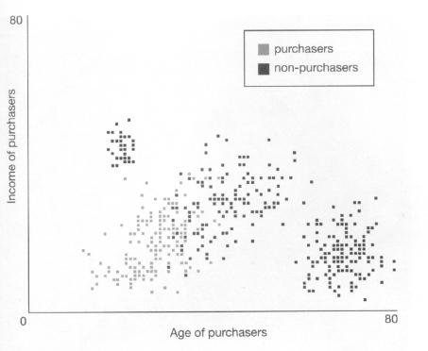
Fig 4-17.

Slide 127
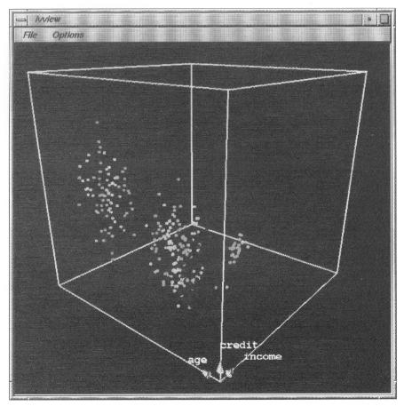
Fig 4-18.

Slide 128
Data Mining Functionalities—What kinds of patterns can be mined?
DM functionalities are used to specify the kind of patterns to be found in DM tasks.
DM tasks can be classified into two categories: descriptive and predictive.
Descriptive mining tasks characterize the general properties of the data in the database.
Predictive mining tasks perform inference on the current data in order to make predictions.

Slide 129
Data Mining Functionalities—What kinds of patterns can be mined?
In some cases, users may have no idea which kinds of patterns in their data may be interesting, and hence may like to search for several different kinds of patterns in parallel.
It is important to have a DM system that can mine multiple kinds of patterns to accommodate different user expectations or applications.

Slide 130
Data Mining Functionalities—What kinds of patterns can be mined?
DM systems should be able to discover patterns at various granularities (different levels of abstraction).
DM systems should allow users to specify hints to guide or focus the search for interesting patterns.

Slide 131
Characterization and Discrimination
Data can be associated with classes or concepts.
E.g., in the AllElectronics store, classes of items for sale include computers and printers, and concepts of customers include bigSpenders and budgetSpenders.
It can be useful to describe individual classes and concepts in summarized, concise, and yet precise terms.
Such descriptions of a class or concept are called class/concept descriptions.

Slide 132
Characterization and Discrimination
These descriptions can be derived via
(a) data characterization, by summarizing the data of the class under study (called target class)
(b) data discrimination, by comparison of the target class with one or a set of comparative classes ( called contrasting classes)
Or (c) both data characterization and discrimination.

Slide 133
Likelihood and Distance
There are other reasons to conceive records as points in a multi-dimensional data space.
The space-metaphor is very useful in a data mining context.
Using this metaphor we can determine the distance between two records in this data space:
Records that are close to each other are very alike

Slide 134
Likelihood and Distance
Records that are very far removed from each other represent individuals that have little in common.
In Fig. 4-19, our sample database contains attributes such as age, income, and credit
These 3 attributes form a 3-dimensional data space and we can analyze the distances between records in this space.

Slide 135
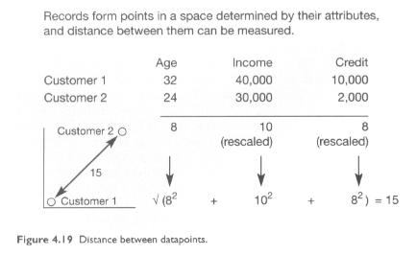
Fig 4-19.

Slide 136
Likelihood and Distance
In order to achieve a good comparison between values, we must normalize the attributes.
Age, e.g., ranges from 1 to about 100 years, while income has a range from 0 to approximately 100,000 dollars a month.
Now if we use this data without correction, income will of course be a much more distinctive attribute than age.

Slide 137
Likelihood and Distance
We divide income by 1000, in order to obtain a measure that is the same order of magnitude as age. We do the same for credit attribute.
If we scale all the attributes to the same order of magnitude we obtain a reliable distance measure between the different records.
In our example, using a Euclidean distance measure, the distance between customer 1 and customer 2 is 15.

Slide 138
Likelihood and Distance
In this way, records become points in a multi-dimensional data space.
We need more advanced search programs to uncover such clusters, and interesting predictions can also be visualized in this way;
Sometimes it is possible to identify a visual cluster of potential customers that are very likely to buy a certain product.
In Fig. 4.20, age, income, and credit form an ideal 3-dimensional space in which to do this kind of clustering analysis.

Slide 139
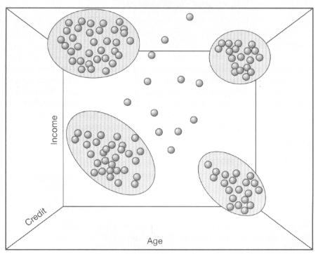
Fig 4-20.

Slide 140
K-nearest Neighbor
When we interpret records as points in a data space, we can define the concept of neighborhood:
Records that are close to each other live in each other’s neighborhood
If we want to predict the behavior of a set of customers and we have a database with records describing these customers.

Slide 141
K-nearest Neighbor
The basic hypothesis required in order to make such a prediction will be that customers of the same type will show the same behavior.
A very simple but powerful learning algorithm – the k-nearest neighbor.
The basic philosophy of k-nearest neighbor is “do as your neighbors do.’

Slide 142
K-nearest Neighbor
If we want to predict the behavior of a certain individual, we start to look at the behavior of, e.g., ten individuals that are close to him in the data space.
We calculate an average of the behavior of these ten neighbors, and the average will be the prediction for our individual.
The letter k in the k-nearest neighbor stands for the number of neighbors we investigate;

Slide 143
K-nearest Neighbor
So 5-nearest neighbor looks at 5 neighbors, and 1-nearest neighbor takes only one individual into account.
Simple k-nearest neighbor is not really a learning technique but more a search method.
It’s one of the purest search techniques, because the data set itself is used as our reference.

Slide 144
K-nearest Neighbor
If we want to make a prediction for each element in the data set containing n records, then we have to compare each record with every other record.
This leads to quadratic complexity, which is not desirable for large data sets.
In general, data mining algorithms should not have a complexity that is higher than n(log n) (where n is number of records)
In practice, we will use the simple k-nearest neighbor technique mainly on sub-samples or data sets of a limited size.

Slide 145
Decision Trees
If you have a table containing data on customer behavior and you want to classify this data or make a prediction, you will find that the tasks of classification and prediction are very closely linked.
An attempt to predict whether a certain customer will show a certain type of behavior in fact implies an assumption that the customer belongs to a certain type of customer group and will therefore show this certain kind of behavior.
Our database contains such as age, income, and credit; now if we want to predict a certain kind of customer behavior, we might ask which of these attributes give us more information.

Slide 146
Decision Trees
If we want to predict who will buy a car magazine, what will help us more – the age or the income of a person ? It could be that age is more important, which implies that only on the basis of knowledge about the age of an individual are we able to predict whether or not he or she will buy a car magazine.
If this is the case, the next thing we have to do is split this attribute in two,that is, we must investigate whether there is a certain age threshold that separates car buyers from non-car buyers.

Slide 147
Decision Trees
We start with the first attribute, find a certain threshold, go on the next one, find a certain threshold.
Repeat this process until we have made a correct classification for our customers, thus creating a decision tree for our database.
There are many algorithms that can construct such a decision tree automatically; they are very effective since they have n(log n) complexity.

Slide 148
Decision Trees
Fig. 4.22 shows the result of applying a tree induction algorithm to the data set.
We would like to have a decision tree that tells us exactly what type of customer would be interested in such a magazine.
We begin by asking for a tree of depth two, describing the readers of the car magazine.

Slide 149
Decision Trees
Age appears to be the most decisive attribute.
The threshold lies at 44.5 years.
Above this age only 1% of people subscribe to a car magazine, while below it 62% of people subscribe to such a magazine.

Slide 150
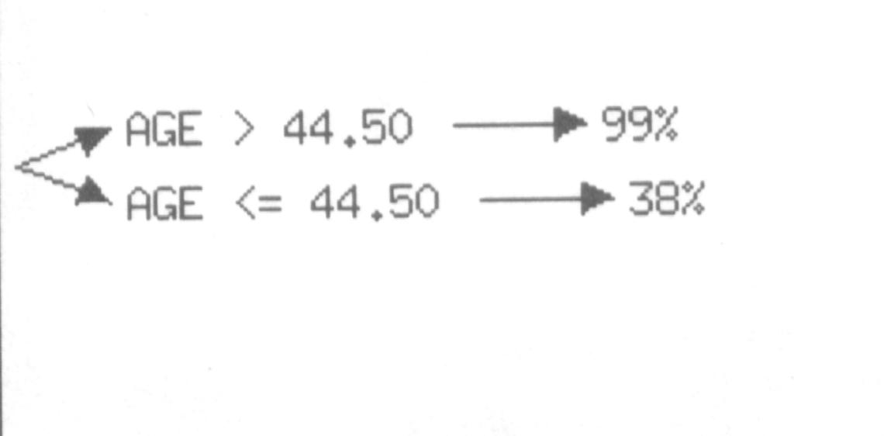
Fig 4-22.

Slide 151
Decision Trees
It is interesting to see what happens when we ask for a somewhat more detailed tree.
Fig. 4.23 show an expansion of the same tree into 4 levels.

Slide 152
Decision Trees
The tree splits the group of people above 44.5 years (almost no readers) into 2 further groups: in one, with an age between 44.5 and 48.5,there is still an 8% readership of the car magazine, while above that age three is no interest in this magazine, so this branch is not explored further by the algorithm.
For the group under 44.5 years, income seems to be the next important attribute.

Slide 153
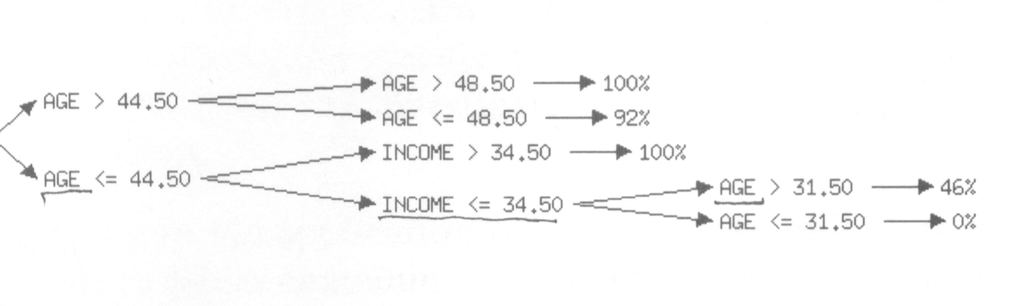
Fig 4-23.

Slide 154
Decision Trees
People with a somewhat higher income (above 34.5) do not read the magazine, but below this income limit, age suddenly becomes decisive again:
All the people in this group under the age of 31.5 subscribe to the magazine.
One of the conclusions we can draw from this tree is that people with an income under 34.5 and an age under 31.5 are very likely to be interested in the car magazine,

Slide 155
Decision Trees
While those with an income above 34.5 and an age under 44.5 will probably not be.
It turns out that a tree of depth 4 is optimal,
Since further expansion of the tree does not yield much more information.

Slide 156
Decision Trees
Fig. 4.24 gives an overview of a maximally expanded tree as an interactive 3-dimensional picture.
The columns at the nodes of the tree represent the number of records that will be in the sub-nodes.
We can see that all but one of the branches stop after 3 levels.

Slide 157
Decision Trees
When we zoom in on this branch (see Fig. 4.25, but remember it is an interactive environment), we see that after one node (age < 31.5) there is very little development.
The columns on all the consecutive nodes have about equal length, so the decisions taken at these nodes have little descriptive value.
3-dimensional environments have much to offer in relation to data mining algorithm.

Slide 158
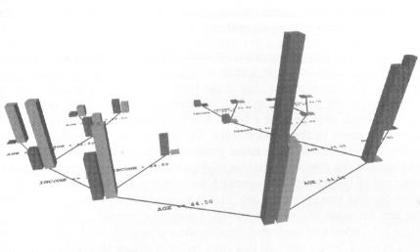
Fig 4-24.

Slide 159
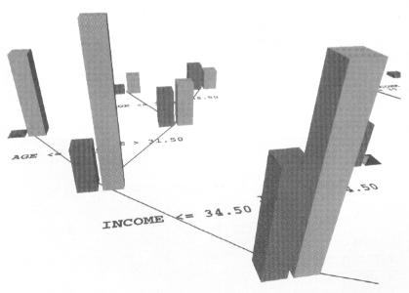
Fig 4-25.

Slide 160
Decision Trees
Advantage (1) scale up very well for large data sets (2) give a true insight into the nature of the decision process
The decision tree that is the result of such an algorithm can be used directly by humans, in direct contrast to, for instance, NNs, which only present a black box that contains no information on how they came to their conclusions.
Limitations~ the data set contains the coordinates of a two-dimensional map of the world.

Slide 161
Association rules
Marketing managers are fond of rules like: 90% of women with red sports cars and small dogs wear Chanel No. 5.
These kinds of descriptions give them clear customer profiles on which to target their marketing actions.
Now one might wonder whether it is possible to find these sorts of rules with data mining tools.
The answer is “yes” and in data mining this type of relationship is called an association rule.

Slide 162
Association rules
Many techniques exist for finding such association rules.
If we have a database containing information on the gender of customers, the color and type of their car, the type of pets they have, and a number of products that they are likely to buy,
Now the rule that was mentioned above would reflect itself in such a database in the following way: for 90% of the records where gender is female, car is sport car, color of car is red, and pet is a small dog, then perfume would be Chanel No. 5.

Slide 163
Association rules
Association rules are always defined on binary attributes, such as those we used in the sample database to represent subscriptions to magazines, so in fact we would have to flatten the table mentioned above before we could execute an associate algorithm.
It’s not very difficult to develop algorithms that will find this association in a large database.

Slide 164
Association rules
We will represent an association rule in the following way:
MUSIC_MAG, HOUSE_MAG => CAR_MAG
This means that somebody that reads both a music and a house magazine is also very likely to read a car magazine.

Slide 165
Association rules
Remember that association rules are defined on binary attributes.
Now which associations are interesting?
In the first place we look for associations that have a lot of examples in the database, and term this process the support of an association rule.

Slide 166
Association rules
In our case the support of the rule is: the percentage of records for which MUSIC_MAG, HOUSE_MAG and CAR_MAG all hold, that is, all the people that read all three magazines.
Support in itself is not enough.
It maybe the case that we have a considerable group of people who read all three magazines but there is a much larger group that reads both MUSIC_MAG and HOUSE_MAG, although not CAR_MAG.

Slide 167
Association rules
In this case the association is very weak, although the support might be relatively high.
We thus need an additional measure-confidence-and in the present case such confidence is the percentage of records for which CAR_MAG holds, within the group of records for which MUSIC_MAG and HOUSE_MAG hold.

Slide 168
Association rules
101 6:35 milk, bread, juice
792 7:38 milk, juice
1130 8:05 milk, eggs
1735 8:40 bread, cookies, coffee
An association rule is of the form X => Y
Where X={x1, x2,…, xn}, and Y={y1, y2,…, ym} are sets of items, with xi and yj being distinct items for all i and all j.
This association states that if a customer buys X, he or she is also likely to buy Y.

Slide 169
Association rules
Any association rule has the form LHS (left-hand side) => RHS (right-hand side), where LHS and RHS are sets of items.
Association rules should supply both support and confidence.
The support for the rule LHS => RHS is the percentage of transactions that hold all of the items in the union, the set LHS RHS.
If the support is low, it implies that there is no overwhelming evidence that items in LHS RHS occur together, because the union happens in only a small fraction of transactions.

Slide 170
Association rules
The rule Mike => Juice has 50% support, while Bread => Juice has only 25% support.
Another term for support is Prevalence of the rule.
To compute confidence we consider all transactions that include items in LHS.
The confidence for the association rule LHS => RHS is the percentage (fraction) of such transactions that also include RHS.

Slide 171
Association rules
Another term for confidence is Strength of the rule.
For Milk => Juice, the confidence is 66.7% (meaning that, of 3 transactions in which milk occurs, two contain juice) and bread => juice has 50% confidence (meaning that one of two transactions containing bread also contain juice).
At present, association rules are only useful in data mining if we already have a rough idea of what it is we are looking for.

Slide 172
Association rules
This illustrates the fact that there is no algorithm that will automatically give us everything that is of interest in the database.
An algorithm that finds a lot of rules will probably also find a lot of useless rules, while an algorithm that finds only a limited number of associations, without fine tuning, will probably also miss a lot of interesting information.

Slide 173
Association rules
In our marketing example concerning magazines, we will first investigate single attribute or unary association rules.
Fig. 4.27 illustrates the associations between the different groups of magazine reader.
WE observe here that for five attributes we already have 25 possible association rules, and this number grows exponentially if we allow multiple attribute associations.
We can see a high correlation between comics and music magazines and between car and music magazines in the figure.

Slide 174
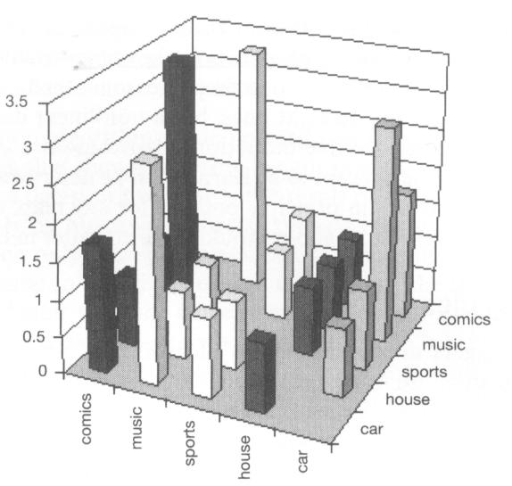
Fig 4-27.

Slide 175
Association rules
Again, as in the case of decision trees, it might be better to use an environment that enables us to zoom in on interesting sets of association rules interactively, and Fig. 4.28 illustrates such an environment.
We have selected CAR_MAG as our target attribute; that is, we are interested in readers of the car magazine.
The confidence and support levels are set at 33% and 3%, which means that we are not interested in sub-groups smaller than 3% of the database, and that within these sub-groups we want to find associations that hold for at least 33% of the records.

Slide 176
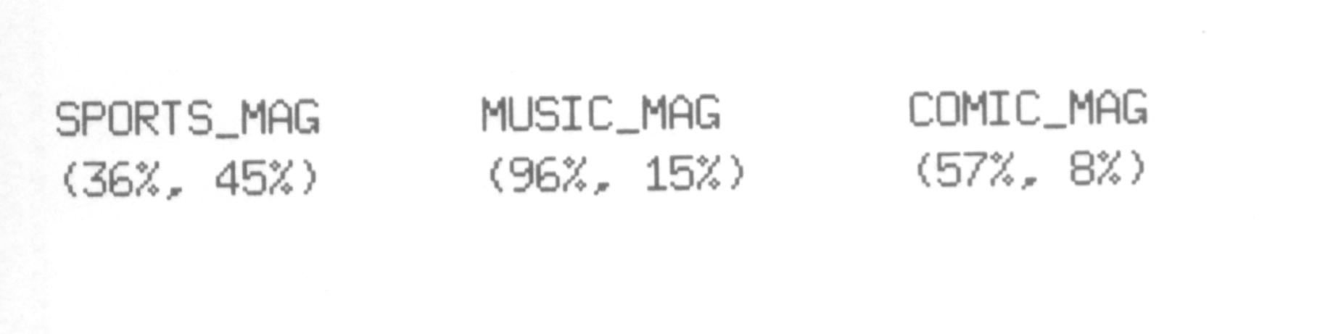
Fig 4-28.

Slide 177
Association rules
In the first stage of our investigation all the relevant attributes are analyzed, and apparently with these confidence and support levels the algorithm finds no association for the house magazine.
The other three magazines, however, lead to the following tentative associative rules:
SPORT_MAG => CAR_MAG
MUSIC_MAG => CAR_MAG
COMIC_MAG => CAR_MAG
The second rule is the most interesting since it has a high confidence level (96%) with a fairly high support

Slide 178
Association rules
The next logical step is to analyze further the potential association involving the music magazine.
The result is shown in Fig. 4.29.
We find 3 new association rules:
MUSIC_MAG, HOUSE_MAG => CAR_MAG
MUSIC_MAG, SPORT_MAG => CAR_MAG

Slide 179
Association rules
MUSIC_MAG, COMIC_MAG => CAR_MAG
Of these 3 rules only the first is relatively interesting: it has a high confidence level (97%) with a fairly high support (9%).
Fig. 4.30 shows what happens when we decide to expand this rule.

Slide 180
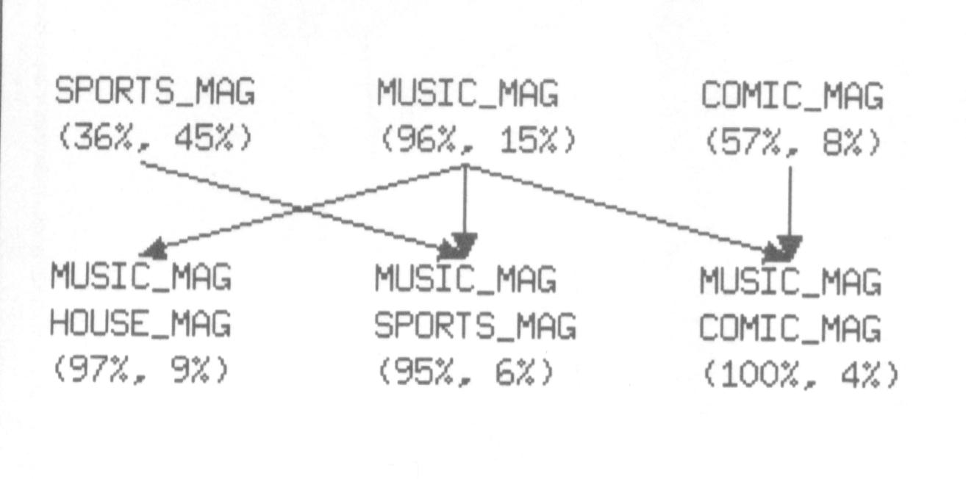
Fig 4-29.

Slide 181
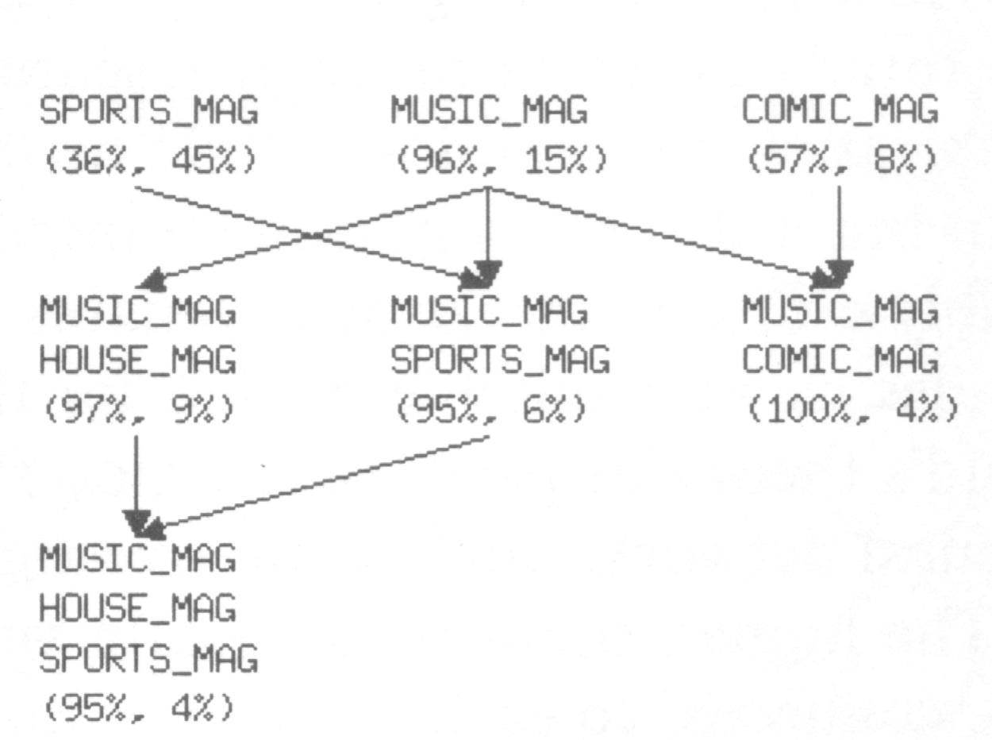
Fig 4-30.

Slide 182
Association rules
We obtain only one new rule:
MUSIC_MAG, HOUSE_MAG, SPORT_MAG => CAR_MAG
But our confidence and support do not increase.
It appears that we cannot do much better than predict an association rule that tells us that all readers of both a music and a house magazine will also read a car magazine with a confidence of 97% and a support of 9%.
Nevertheless, such a rule could be valuable in a marketing context.

Slide 183
Neural networks (NNs)
Many machine-learning techniques are derived from paradigms related to totally different areas of research.
Genetic algorithms derive their inspiration from biology while NNs are modeled on the human brain.
Learning is such an important aspect of nature that it inevitably crops up in various domains of study of living beings and provides us with suitable models for the study of learning behavior.
In Freud’s theory of psychodynamics, the human brain was described as a NN, and recent investigations have corroborated this view.

Slide 184
NNs
The human brain consists of a very large number of neurons, about 10¹¹, connected to each other via a huge number of so-called synapses.
A single neuron is connected to other neurons by a couple of thousand of these synapses.
Although neurons could be described as the simple building blocks of the brain, the human brain can handle very complex tasks despite this relative simplicity.
This analogy therefore offers an interesting model for the creation of more complex learning machines, and has led to the creation of so-called artificial neural networks.

Slide 185
NNs
Such networks can be built using special hardware but most are just software programs that can operate on normal computers.
Typically, a NN consists of a set of nodes:
input nodes => receive the input signal

Slide 186
NNs
Output nodes => give the output signals
Intermediate nodes => a potentially unlimited number of intermediate layers
There are various different architectures for NNs, and they each utilize different wiring and learning strategies to perform tasks.

Slide 187
NNs
When using NNs we have to distinguish between two stages:
The encoding stage~ in which the NN is trained to perform a certain task.
The decoding stage~ in which the network is used to classify examples, and make predictions, or execute whatever learning task is involved.

Slide 188
NNs
There are several different forms of NN but we shall discuss only 3 of them here:
Perceptrons
Back propagation networks
Kohonen self-organizing map

Slide 189
NNs
Perceptron~1958 Frank Rosenblatt of Cornell Aeronautical Lab built.
A perceptron consists of a simple 3-layered network with input units called photo-receptors, intermediate units called associators, and output units called responders.
The perceptron could learn simple categories and thus could be used to perform simple classification tasks.

Slide 190
NNs
Somewhat later, in 1969, Minsky and Papert showed that the class of problem that could be solved by a machine with a perceptron architecture was very limited.
It was only in the 1980s that researchers began to develop neural networks with a more sophisticated architecture that could overcome these difficulties.
A major improvement was the introduction of hidden layers in the so-called back propagation networks.

Slide 191
NNs
A back propagation network not only has input and output nodes, but also a set of intermediate layers with hidden nodes.
In its initial stage a back propagation network has random weightings on its synapses.
When we train the network, we expose it to a training set of input data.

Slide 192
NNs
For each training instance, the actual output of the network is compared with the desired output that would give a correct answer;
If there is a difference between the correct answer and the actual answer, the weightings of the individual nodes and synapses of the network are adjusted.
Once the structure of the network stabilizes, the learning stage is over, and the network is now trained and ready to categorize unknown input.
Fig. 4.31 represents a simple architecture of a NN that can perform an analysis on part of our marketing database.

Slide 193
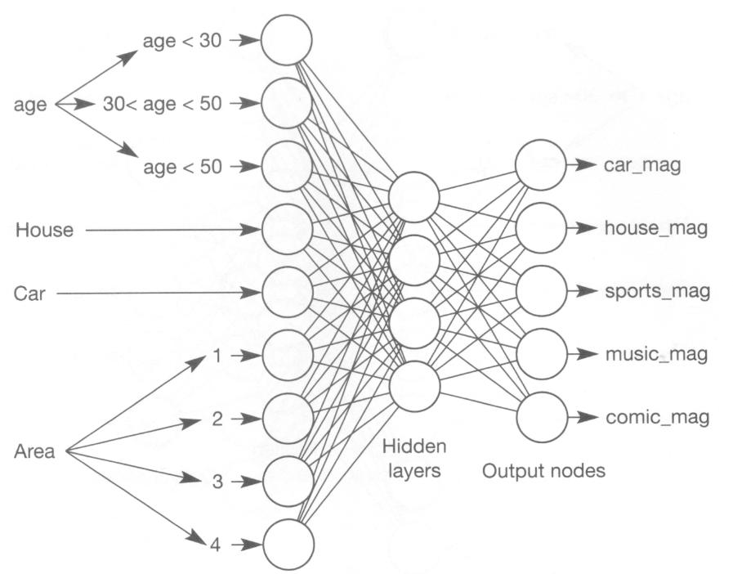
Fig 4-31.

Slide 194
NNs
The age attribute has been split into 3 age classes, each represented by a separate input node;
House and car ownership also have an input node
There are 4 additional nodes identifying the 4 areas, so that in this way each input node corresponds to a simple yes-no decision.
The same holds for the output nodes: each magazine has a node.
It is clear that this coding corresponds well with the information stored in the database.

Slide 195
NNs
The input nodes are wholly interconnected to the hidden nodes, and the hidden nodes are wholly interconnected to the output nodes.
In an untrained network the branches between the nodes have equal weights.
During the training stage the network receives examples of input and weights of the different branches until all the inputs match the appropriate outputs.
In Fig. 4.32 the network learns to recognize readers of the car magazine and the comics.

Slide 196
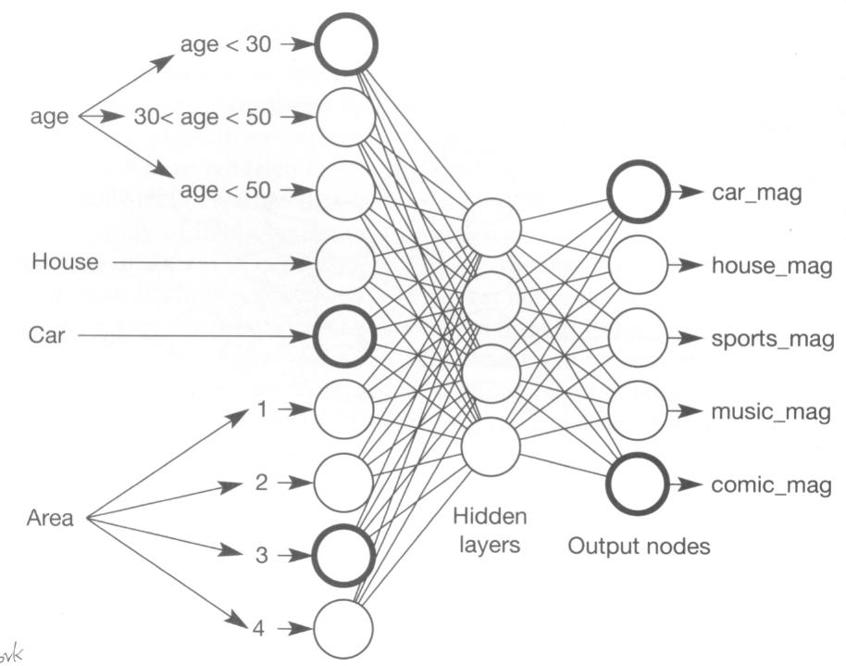
Fig 4-32.

Slide 197
NNs
Fig. 4.33 shows the internal state of the network after training.
The configuration of the internal nodes shows that there is a certain connection between the car magazine and comics readers.
However, the networks do not provide a rule to identify this association.

Slide 198
NNs
Back propagation networks are a great improvement on the perceptron architecture.
They also have disadvantages, one being that they need an extremely large training set.
Another problem of NNs is that although they have learned- they do not provide us with a theory about what they have learned.

Slide 199
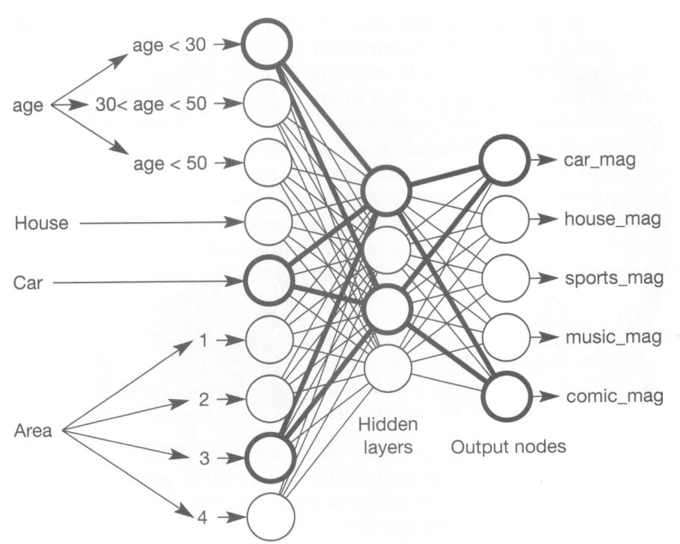
Fig 4-33.

Slide 200
NNs
In 1981 Tuevo Kohonen demonstrated a completely different version of NNs that is currently known as Kohonen’s self-organizing maps.
These NNs can be seen as the artificial counterparts of maps that exist in several places in the brain, such as visual maps, maps of the spatial possibilities of limbs, and so on.
A Kohonen self-organization map is a collection of neurons or units, each of which is connected to a small number of other units called its neighbors.

Slide 201
NNs
Most of the time, the Kohonen map is 2-dimensional
Each node or unit contains a factor that is related to the space whose structure we are investigating.
In its initial setting, the SOM has a random assignment of vectors to each unit.
During the training stage, these vectors are incrementally adjusted to give a better coverage of the space.

Slide 202
NNs
A natural way to visualize the process of training a SOM is the so-called Kohonen movie, which is a series of frames showing the positions of the vectors and their connections with neighboring cells.
The network resembles an elastic surface that is pulled out over the sample space.
NNs perform well on classification tasks and can be very useful in data mining.

Slide 203
NNs
In Fig. 4.34 we illustrate the application of a SOM to our sample space.
The first picture gives the initial state of the vectors, while subsequent stages show how the SOM gradually works towards a better coverage of the sample space.
This is a neat illustration of the learning process of an artificial NN.

Slide 204
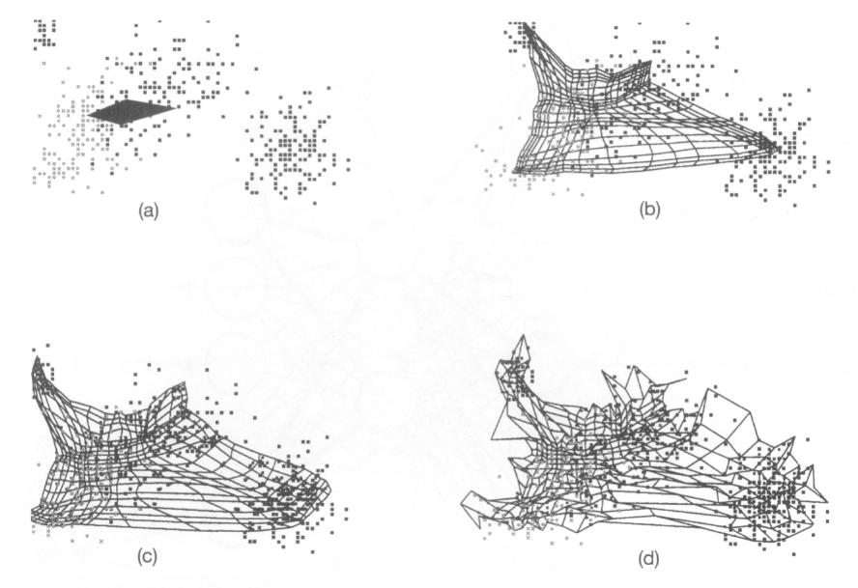
Fig 4-34.

Slide 205
Genetic Algorithms
There is a fascinating interaction between technology and nature, and by means of technical inventions we can learn to understand nature better.
Conversely, nature is often a source of inspiration for technical breakthroughs.
The same principle also applies to computer science, a most fertile area for exchange of views between biology and computer science being “evolutionary computing.”

Slide 206
Genetic Algorithms
Evolutionary computing occupies itself with problem solving by the application of evolutionary mechanisms.
This area evolved from 3 more or less independent developments:GAs, evolutionary programming, and evolution strategies.

Slide 207
GAs
All 3 of these were initially studied in the 1960s and 1970s (the first 2 in the USA, the third in Germany), but it was not until the end of the 1980s that they began to be accepted.
Around this time, investigators began to see a strong relationship between these areas, and a close-knit community of researchers also developed in Europe.
At the present time, Gas are considered to be among the most successful machine-learning techniques.

Slide 208
GAs
Why can they be used so easily and what kinds of techniques did we ‘borrow’ from nature?
Nature has provided inspiration for 2 issues: “survival of the fittest’ as a technique for solving problems, and DNA as a technique for coding problems.
In ‘The Origin of Species”, Darwin described the theory of evolution, with “natural selection” as the central notion.

Slide 209
GAs
Each species has an over-production of individuals and in a tough struggle for life, only those individuals that are best adapted to the environment survive.
If we were to exempt all Americans with big noses from taxation, in 5 hundred years’ time, everyone in the USA would sport big noses.
In itself, this view is not yet sufficient for the computerization of evolutionary systems;
What is lacking is an adequate theory that tells us how genetic information is transferred.

Slide 210
GAs
In 1953 James Watson and Francis Crick discovered the double-spiral structure of DNA; hereditary information is stored in long DNA molecules, consisting of only 4 building blocks, which means that all the hereditary information of a human individual, or of any living creature, has been laid down in a language of only 4 letters (C, G, A, and T in the language of genetics).
The collection of genetic instructions for humans is about 3 billion letters long – which is enough to fill some thousand Bibles.

Slide 211
GAs
Each individual inherits some characteristics of the father and some of the mother.
Individual differences between people, such as hair and eye color, and also pre-disposition for diseases, are caused by differences in genetic coding.
It is now clear how Darwin’s finches came into being: they obviously possessed a number of genes that allowed them to vary the length of their bills, giving the original population considerable variety, and the struggle for life did the rest.

Slide 212
GAs
Why nature has used this mechanism for optimization and development?
The mechanism of natural selection
Disadvantage~(1) the large over-production of individuals. (2) the whole process has little purpose, since improvement of the species depends on chance that such a mutation really leads to something significant is as great as that of a monkey writing Song of Songs by hammering on a word processor (remember the thousand Bibles).

Slide 213
GAs
Advantage~(1) solidity and inherent parallelism.
(2) Although this involves extra effort, the process does not become trapped in a local optimum.
If a solution exists, a GA will probably find it.
GAs can be viewed as a kind of meta-learning strategy, which means that the genetic approach could be employed by individuals who at the moment use almost any other learning mechanism.

Slide 214
GAs
The past few years have seen the development of many hybrid approaches, in which NNs have been used to create hybrid approaches, in which NNs have been used to create input for GAs, or alternatively GAs to optimize the output of NNs.
At present, genetic programming is widely used in financial markets and for insurance applications.
If we want to discover a good clustering from our magazines database using GA.

Slide 215
GAs
The first step is to find an elegant coding of the problem in terms of strings of a limited alphabet, and one way to deal with this would be to describe a clustering as a set of guide points in the space we are investigating.
Fig. 4.35 shows a good clustering of a sample space in terms of 5 guide points.
The guide points describe cluster areas of our search space, the border between 2 guide points being defined by a line equidistant from both points.

Slide 216
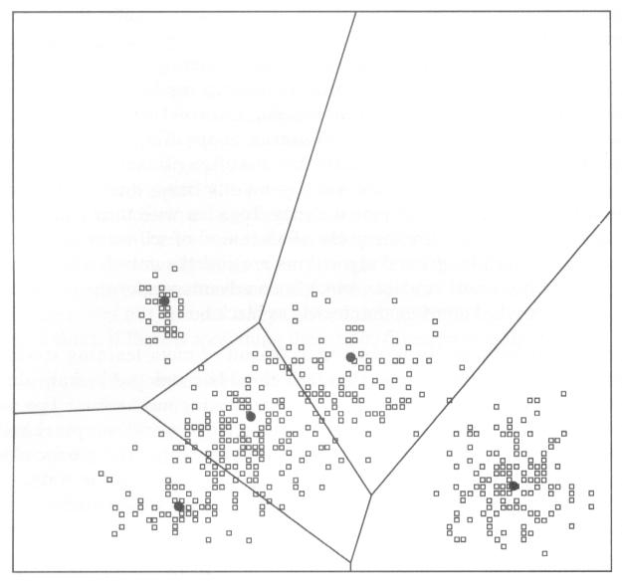
Fig 4-35.

Slide 217
GAs
The division into different areas that results from the definition of these borders is called a Voronoi diagram.
Using the technique of Voronoi diagrams we can divide a sample space into different regions according to the set of guide points we have found.
In this case we have 5 such regions that give a rough classification of our sample space.

Slide 218
GAs
Had we used more guide points, we would probably have obtained a better division of the space into sub-regions.
In the case of our cluster algorithm, we could choose the string consisting of the coordinates of our 5 guide points as a coding for a potential solution to the problem.
An individual in our search space would then consisting of ten real numbers describing the coordinates of 5 points.
We could start our GA with a number of individuals each describing 5 guide points.

Slide 219
GAs
In Fig. 4.36 this set of initial random solutions is represented as the first generation.
The next thing we have to work out is a good fitness function for individuals.
We just take the average distance of the points in the sample space to the closet guide point.
A set of guide points will give a better clustering if the average distance of all the points to the closest guide point is minimal.

Slide 220
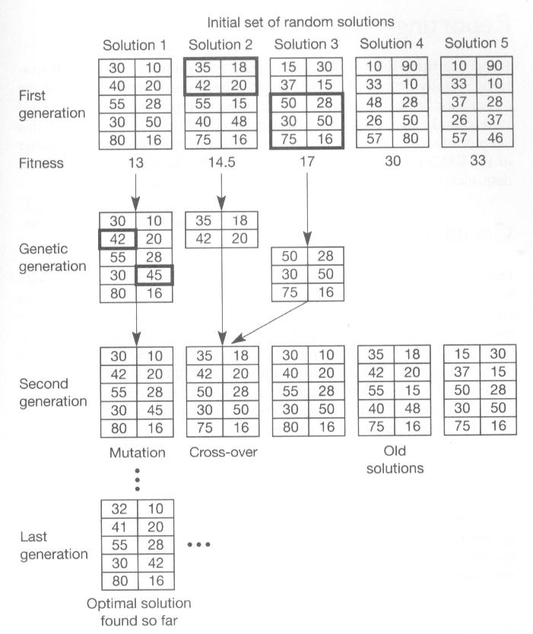
Fig 4-36.

Slide 221
GAs
In Fig. 4.36 the solutions are already ordered according to average distance.
The last thing we have to take care of is defining good cross-over and mutation relationships.
In this case, cross-over is also very simple; we simply take 3 points from one individual, two points from another individual, exchange them, and in this way create 2 new progeny out of parents.

Slide 222
GAs
Mutation is even simpler: we merely move some points of an individual around in the search space in a random way.
Using these cross-over and mutation operators we can create new generations of solutions for our problem.

Slide 223
GAs
After a certain number of generations, we will find a stable clustering for the sample space, which will look more or less the same as the one shown in Fig. 4.35.
This example shows how GAs can be used to solve clustering problems.

Slide 224
Different learning algorithms compared with different types of task
One might wonder whether there is a relationship between different types of problem and certain machine-learning techniques.
Moustakis have interviewed about a 100 specialists in the area of machine learning.
The aim was to investigate their opinion on the usability of certain machine-learning techniques for certain types of task.

Slide 225
Different learning algorithms compared with different types of task
After statistical analysis of the results, they finally factored out 3 main task areas – knowledge engineering, classification, and problem solving.
They succeeded in plotting out each of the learning techniques in this 3-dimensional space.
A simplified version of the results is represented in Fig. 5.2.

Slide 226
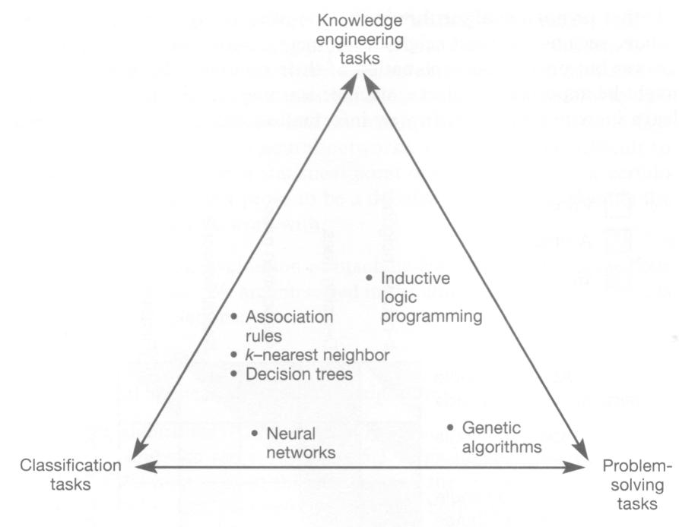
Fig 5-2.

Slide 227
Different learning algorithms compared with different types of task
NNs → classification tasks
GAs → problem solving tasks
Inductive logic programming → knowledge engineering tasks
One lesson we learn from this is that there is no single best machine-learning or pattern recognition technique:

Slide 228
Different learning algorithms compared with different types of task
Different tasks pre-suppose different kinds of techniques.
A KDD environment therefore must support these different types of techniques, and such an environment is called hybrid.

Slide 229
Different learning algorithms compared with different types of task
Suppose we want to detect fraud in a KDD environment.
As this is very complex and encompasses tasks in the areas of knowledge engineering, classification, and problem solving, we need to use different techniques at various stages of the analysis of the data set.

Slide 230
Different learning algorithms compared with different types of task
In some cases, k-nearest neighbor as a technique does well, in other cases decision trees give a better analysis of the data set.
This illustrates the validity of a multiple strategy approach to data mining.

